Slide 1
Computational Thermal Engineering
Mathematical description of physical phenomena – DAY 2
Kumaresh Selvakumar

Slide 2
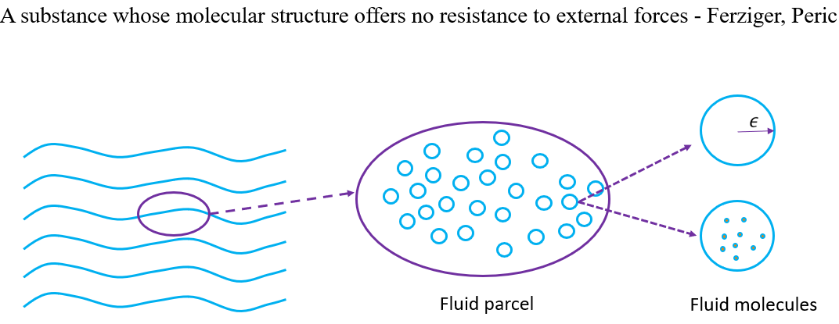
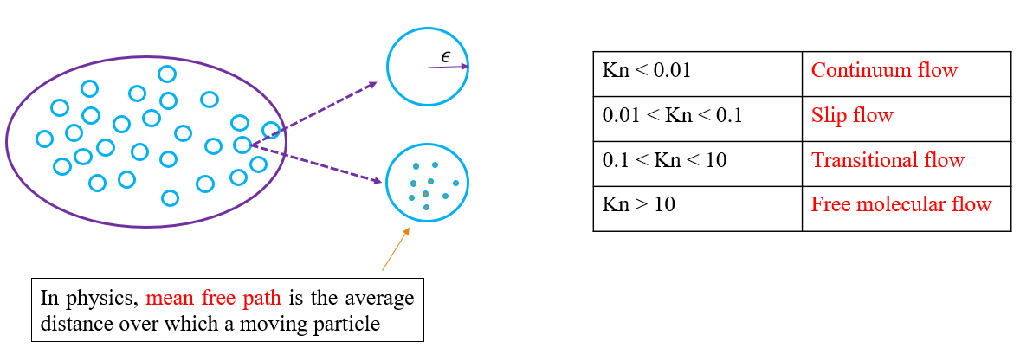
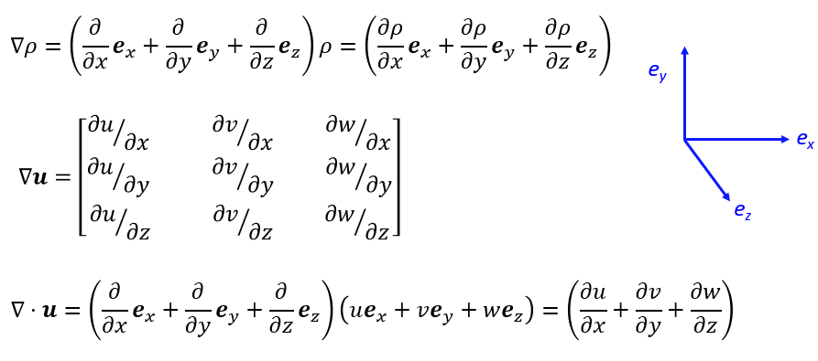
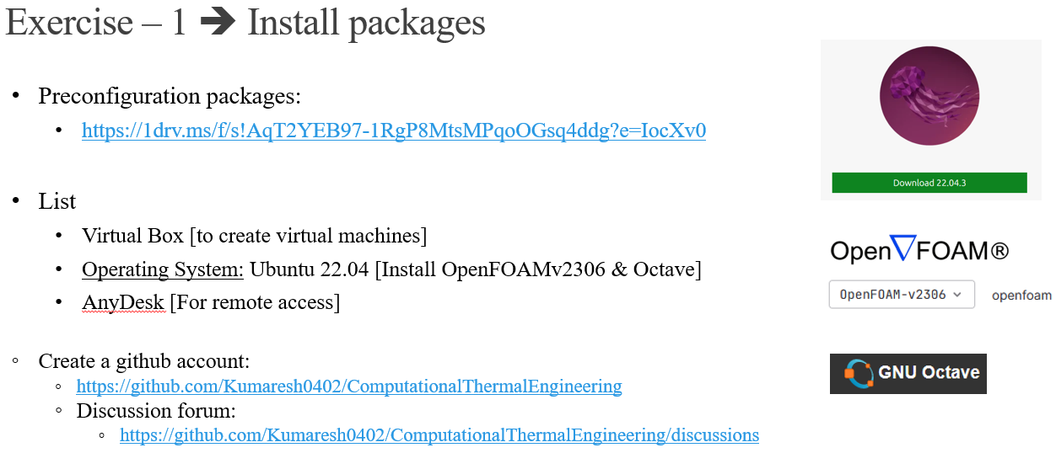
Quick Recap

Slide 3
Contents
Mathematical operations
Taylor series expansion and FDM
Analytical and Numerical solutions + Exercises – 1 and 2
Lagrangian and Eulerian frames
Governing Equations
Gauss Divergence and Reynolds Transport theorems
Exercises

Slide 4
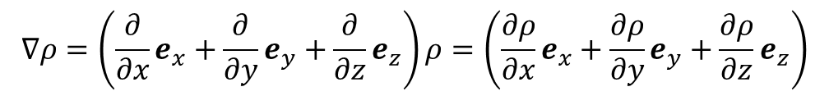
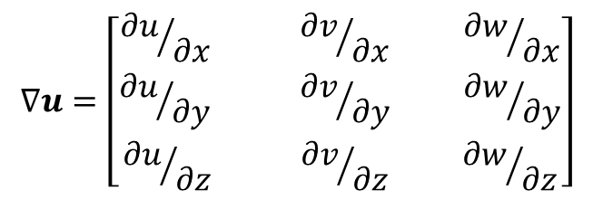
Mathematical operations
Gradient and Divergence:
e_{y}
e_{x}
e_{z}

Slide 5
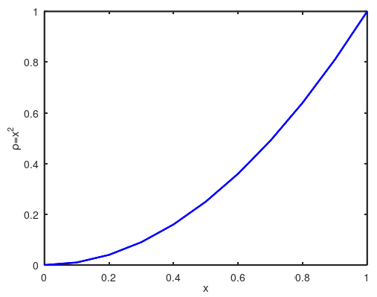
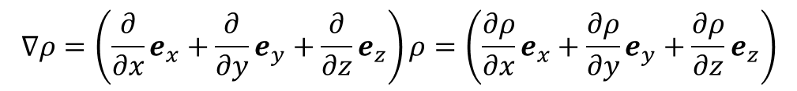
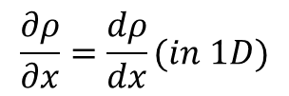
Mathematical operations
Gradient
e_{y}
e_{x}
e_{z}

Slide 6
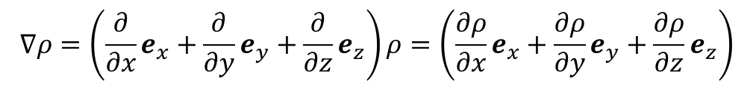
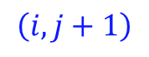
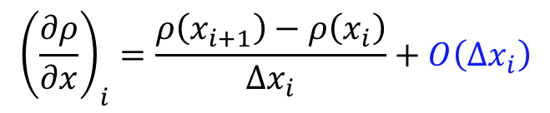
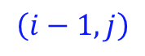
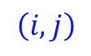
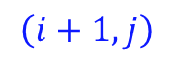
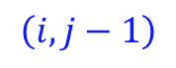
Finite Difference Method (FDM)

Slide 7

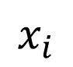
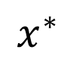
Taylor series expansion
$$ρ\left(x^{∗}\right)=ρ\left(x_{i}\right)+\left(x^{∗}−x_{i}\right){\left(\frac{dρ}{dx}\right)}_{i}+{\left(x^{∗}−x_{i}\right)}^{2}{\left(\frac{d^{2}ρ}{dx^{2}}\right)}_{i}+{\left(x^{∗}−x_{i}\right)}^{3}{\left(\frac{d^{3}ρ}{dx^{3}}\right)}_{i}+…$$
Notes:
https://www.youtube.com/watch?v=Z7sDYzJjMa4
T_n(x) = f(a) + (f’(a) /1!) (x-a) + (f^2(a)/2!) (x-a)^2 + ……
T_5(x) = f(0) + (f’(0) /1!) (x-0) + (f^2(0)/2!) (x)^2 + ……
f(x) = e^x; f(0) = 1
f'(x) = e^x; f’(0) = 1
f^2(x) = e^x; f^2(0) = 1
f^3(x) = e^x; f^3(0) = 1
f^4(x) = e^x; f^4(0) = 1
f^5(x) = e^x; f^5(0) = 1
f(x) = sinx; f(0) = 0
f'(x) = cosx; f’(0) = 1
f^2(x) = -sinx; f^2(0) = 0
f^3(x) = -cosx; f^3(0) = -1
f^4(x) = sinx; f^4(0) = 0
f^5(x) = cosx; f^5(0) = 1

Slide 8
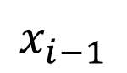
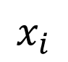
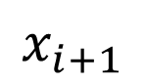
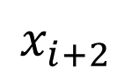
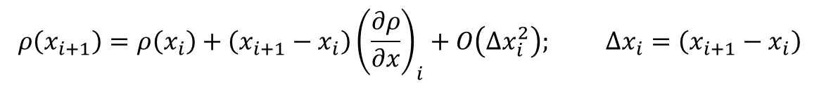
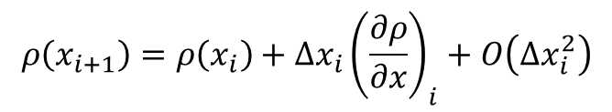
Taylor series expansion

Slide 9
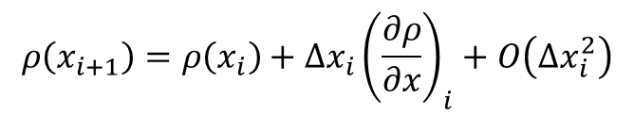
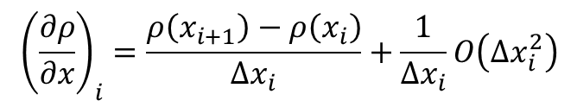
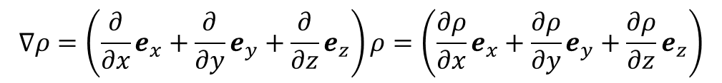
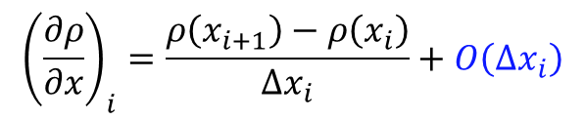
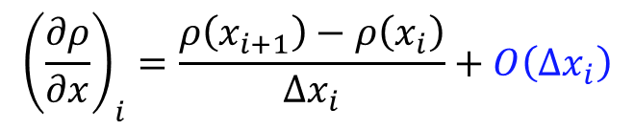
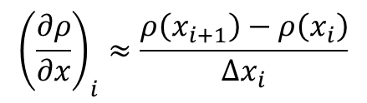
Taylor series and FDM
Taylor series:
Finite difference

Slide 10
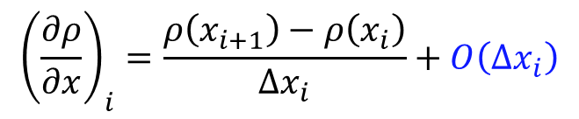
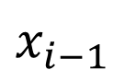
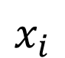
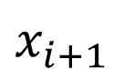
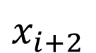
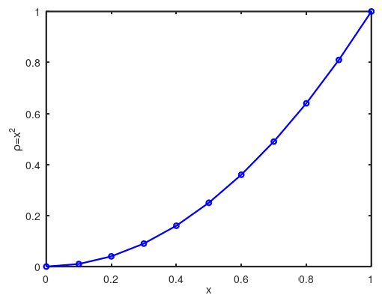
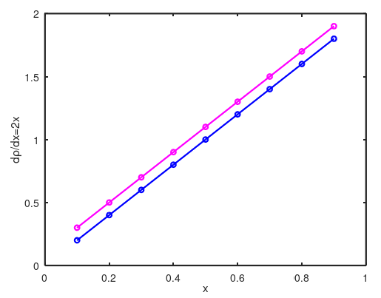
Analytical and Numerical solutions
Numerical result
Resolved in OCTAVE
Analytical result

Slide 11
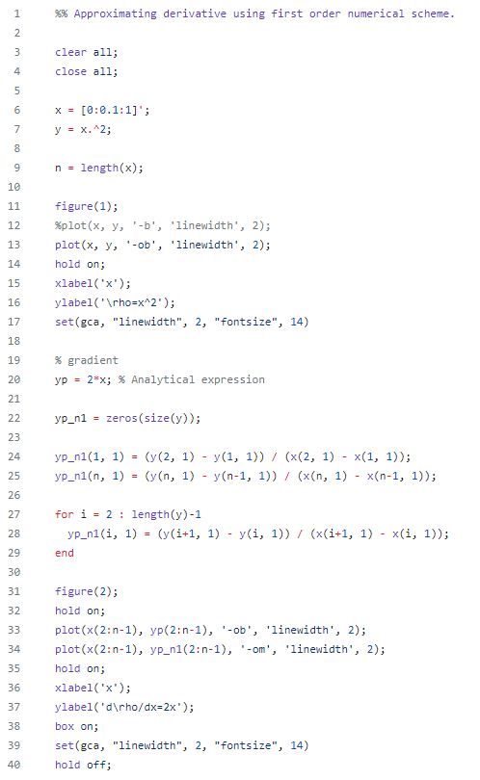
Analytical and Numerical solutions
Exercise – 2
OCTAVE
Analytical | Numerical
An analytical solution involves framing the problem in a well-understood form and calculating the exact solution. | A numerical solution means making guesses at the solution and testing whether the problem is solved well enough to stop.
Numerical result
Analytical result
Notes:
'gca' sets the current axes for the current figure which is created before.
a = linspace(0,10,150);
Can everyone solve this problem for first order (forward) upwind scheme
Can everyone solve this problem for x^ 2 and x^3
Can everyone solve this problem for first order (backward) downwind scheme

Slide 12
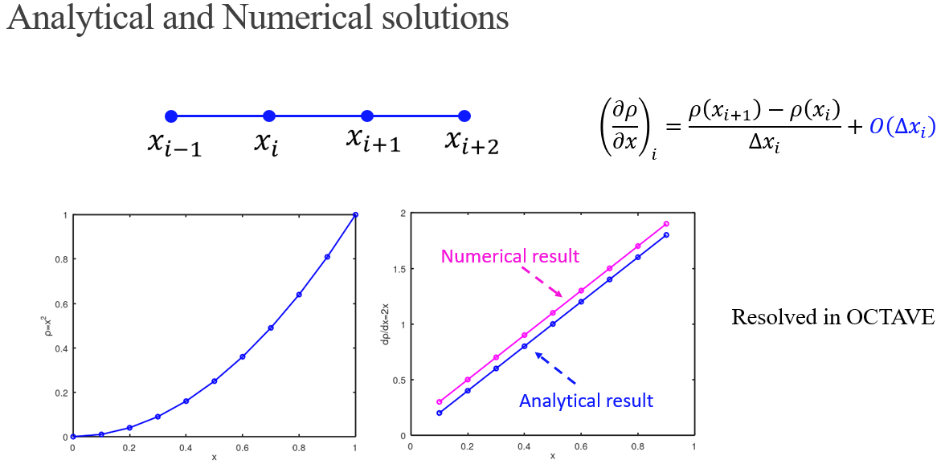
Exercise – 2 ➔ Octave
Notes:
'gca' sets the current axes for the current figure which is created before.
a = linspace(0,10,150);
Can everyone solve this problem for x^ 2 and x^3
Can everyone solve this problem for first order (forward) upwind scheme
Can everyone solve this problem for first order (backward) downwind scheme

Slide 14
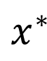
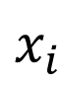
Taylor series: Discrete Operations
$$x_{i}$$
$$x^{∗}$$
$$ρ\left(x^{∗}\right)=ρ\left(x_{i}\right)+\left(x^{∗}−x_{i}\right){\left(\frac{dρ}{dx}\right)}_{i}+{\left(x^{∗}−x_{i}\right)}^{2}{\left(\frac{d^{2}ρ}{dx^{2}}\right)}_{i}+{\left(x^{∗}−x_{i}\right)}^{3}{\left(\frac{d^{3}ρ}{dx^{3}}\right)}_{i}+…$$

Slide 15
Taylor series: Discrete Operations

Slide 16
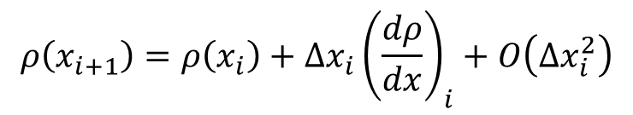
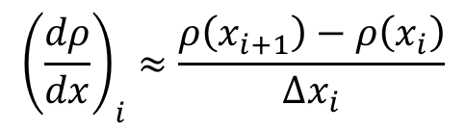

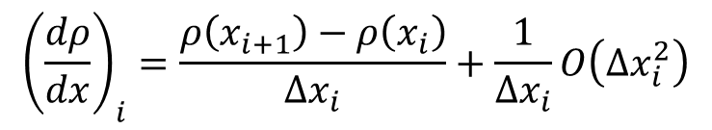
Taylor series: Discrete Operations
$$ρ\left(x_{i+1}\right)=ρ\left(x_{i}\right)+Δx_{i}{\left(\frac{dρ}{dx}\right)}_{i}+O\left(Δx_{i}^{2}\right)$$
$${\left(\frac{dρ}{dx}\right)}_{i}=\frac{ρ\left(x_{i+1}\right)−ρ\left(x_{i}\right)}{Δx_{i}}+\frac{1}{Δx_{i}}O\left(Δx_{i}^{2}\right)$$
$${\left(\frac{dρ}{dx}\right)}_{i}=\frac{ρ\left(x_{i+1}\right)−ρ\left(x_{i}\right)}{Δx_{i}}+O\left(Δx_{i}\right)$$
$${\left(\frac{dρ}{dx}\right)}_{i}≈\frac{ρ\left(x_{i+1}\right)−ρ\left(x_{i}\right)}{Δx_{i}}$$
First order upwind scheme

Slide 17
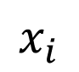
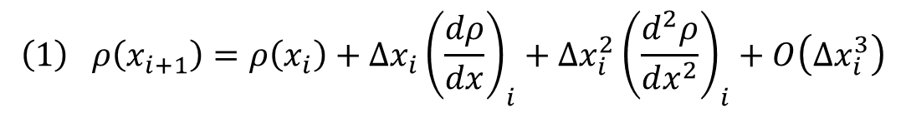
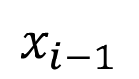
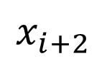
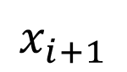

Taylor series: Central Difference Scheme (2nd order)
$$x_{i−1}$$
$$x_{i}$$
$$x_{i+1}$$
$$x_{i+2}$$
$$ρ\left(x_{i+1}\right)=ρ\left(x_{i}\right)+\left(x_{i+1}−x_{i}\right){\left(\frac{dρ}{dx}\right)}_{i}+{\left(x_{i+1}−x_{i}\right)}^{2}{\left(\frac{d^{2}ρ}{dx^{2}}\right)}_{i}+{\left(x_{i+1}−x_{i}\right)}^{3}{\left(\frac{d^{3}ρ}{dx^{3}}\right)}_{i}+…$$
$$\left(1\right) ρ\left(x_{i+1}\right)=ρ\left(x_{i}\right)+Δx_{i}{\left(\frac{dρ}{dx}\right)}_{i}+Δx_{i}^{2}{\left(\frac{d^{2}ρ}{dx^{2}}\right)}_{i}+O\left(Δx_{i}^{3}\right)$$
$$\left(2\right) ρ\left(x_{i−1}\right)=ρ\left(x_{i}\right)−Δx_{i}{\left(\frac{dρ}{dx}\right)}_{i}+Δx_{i}^{2}{\left(\frac{d^{2}ρ}{dx^{2}}\right)}_{i}+O\left(Δx_{i}^{3}\right)$$

Slide 18



Taylor series: Central Difference Scheme (2nd order)
$$x_{i−1}$$
$$x_{i}$$
$$x_{i+1}$$
$$x_{i+2}$$
Subtract (2) from (1)
$$ρ\left(x_{i+1}\right)−ρ\left(x_{i−1}\right)=2Δx_{i}{\left(\frac{dρ}{dx}\right)}_{i}+O\left(Δx_{i}^{3}\right)$$
$${\left(\frac{dρ}{dx}\right)}_{i}=\frac{ρ\left(x_{i+1}\right)−ρ\left(x_{i−1}\right)}{2Δx_{i}}+O\left(Δx_{i}^{2}\right)$$

Slide 19



Taylor series: Summary
$$x_{i−1}$$
$$x_{i}$$
$$x_{i+1}$$
$$x_{i+2}$$
First order upwind
Second order central difference

Slide 21





Lagrangian frame – discrete phase
Fluid parcel

Slide 22
Eulerian frame
Conservation laws are applied around a fixed “control volume” in space
Flux of quantities through the boundary is used to estimate the flow variables
Useful to take observations at fixed locations
Notes:
'gca' sets the current axes for the current figure which is created before.
a = linspace(0,10,150);

Slide 24
Governing Equations
The general equation can be written in the form as:
1
2
3
4
1
Unsteady/Transient term
3
Diffusion term
2
Advection/Convection term
4
Source term

Slide 25
Governing Equations
Continuity equation:
➔
Momentum equation:
➔
Energy equation:
➔
Species equation:
➔
Turbulence equation:
➔
Ideal Gas equation:

Slide 26












Finite Difference – Finite Volume
Differential form
Integral form
Notes:
This is where I want to introduce you to finite difference and finite volume approaches
Integral form: is in OpenFOAM
We will use differential form in Octave

Slide 27




Integral Form – Differential Form
Conservation of mass
Integrate over a control volume
Gauss – divergence theorem

Slide 29







Gauss Divergence Theorem

Slide 30




Gauss Divergence Theorem
Rate of change of a quantity over a control volume = Rate of flow through control surface.

Slide 31





Gauss Divergence Theorem
e_{y}
e_{x}
e_{z}

Slide 32









Gauss Divergence Theorem

Slide 34



Reynolds Transport Theorem

Slide 35









Reynolds Transport Theorem
Control volume
System

Slide 36




Reynolds Transport Theorem
Subtract (1) from (2)

Slide 37




Reynolds Transport Theorem

Slide 38




Conservation Laws
Conservation of mass
Conservation of momentum
Scalar conservation law

Slide 40


Exercise – 3 ➔ Octave
Compare first order upwind and backwind with second order central difference method ?
Why second order central difference method is highly accurate ?
Derive expression for ${\left(\frac{d^{2}ρ}{dx^{2}}\right)}_{i}$.What is the accuracy of the resultant expression?
Notes:
Can everyone solve this problem for x^ 2 and x^3
Can everyone solve this problem for first order (forward) upwind scheme
Can everyone solve this problem for first order (backward) downwind scheme
Can everyone solve this problem for second order central difference scheme

